Slide 1
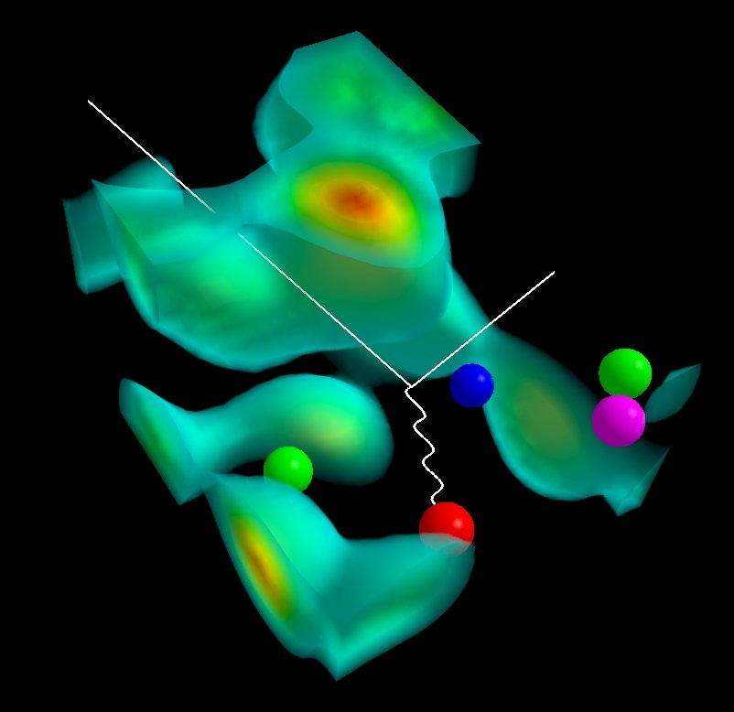




Symmetry Violation and Standard Model Tests
− the NuTeV Anomaly
Anthony W. Thomas
8th Circum-Pan Pacific Spin Conference
Cairns: June 23rd 2011

Slide 2
Outline
In the case of crucial experiments:
What should the PDG show?
A) Result of experimental group ignoring later corrections
or
B) Reanalysis incorporating best estimates
(with appropriate errors) of those corrections
Clearly I believe that B) is the correct answer
BUT let me explain the case of NuTeV
and then we can have a discussion...

Slide 3
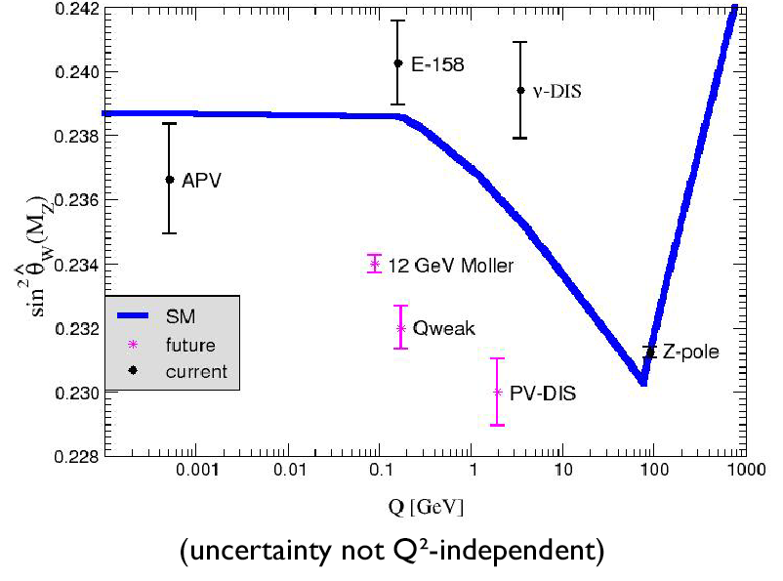
Test of Weak Neutral Current in Standard Model
Not so long ago….
3 σ
SM line: Erler et al., Phys.Rev.D72:073003,2005

Slide 4
Paschos-Wolfenstein Ratio
NuTeV measured (approximately) P-W ratio:
_ _
σ (ν Fe → ν X) - σ (ν Fe → ν X) NC
R^{PW} = = ratio
σ (ν Fe → μ⁻ X) - σ (ν Fe →μ⁺ X) CC
_
= ½ - sin² θ_{W}
NuTeV
sin² θ_{W} = 1 – M_{W}²/M_{Z}² = 0.2277 ± 0.0013 ± 0.0009
other methods
c.f. Standard Model = 0.2227 ± 0.0004

Slide 5
NuTeV Anomaly
Phys. Rev. Lett. 88 (2002) 091802 : > 400 citations since….
Fermilab press conference, Nov. 7, 2001:
“We looked at sin² θ_{W} ,” said Sam Zeller. The predicted value was
0.2227. The value we found was 0.2277…. might not sound like
much, but the room full of physicists fell silent when we first
revealed the result.”
“3 σ discrepancy : 99.75% probability ν are not like other
particles…. only 1 in 400 chance that our measurement
is consistent with prediction ,” MacFarland said.

Slide 6
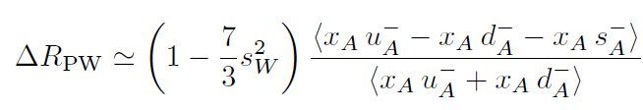
Corrections to Paschos-Wolfenstein Relation
General form of the correction is:
u_{A} = u^{p} + u^{n} ; d_{A} = d^{p} + d^{n} and hence (after correcting for N ≠ Z)
u_{A} – d_{A} = (u^{p} – d^{n}) – (d^{p} – u^{n} ) ≡ δu – δd
N.B. In general the corrections are C-odd and so involve only
valence distributions: q⁻ = q – q
We consider first the last piece, involving the strange quark asymmetry: we need < x (s – s) >
_
_
Davidson et al., hep-ph/0112302

Slide 7
Symmetry Breaking and PDFs
Breaking of the symmetries of QCD has profound consequences for PDFs
d > u : predicted on basis of chiral symmetry 1983*
− found as violation of Gottfried sum-rule by NMC 1992
s(x) ≠ s(x) : first predicted again on basis of chiral symmetry 1987#
Charge symmetry violation 1993 (Sather & Rodionov et al.)
Such subtle effects may have profound consequences when searching for “violations” of Standard Model physics
_
_
_
* AWT, Phys Lett B126 (1983) 98
# Signal & Thomas, Phys Lett B191 (1987) 205

Slide 8
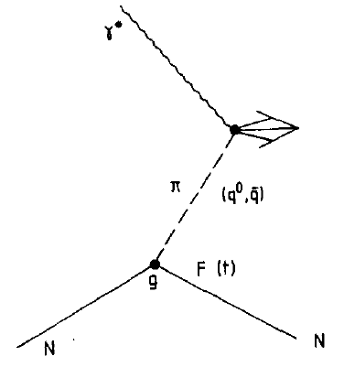
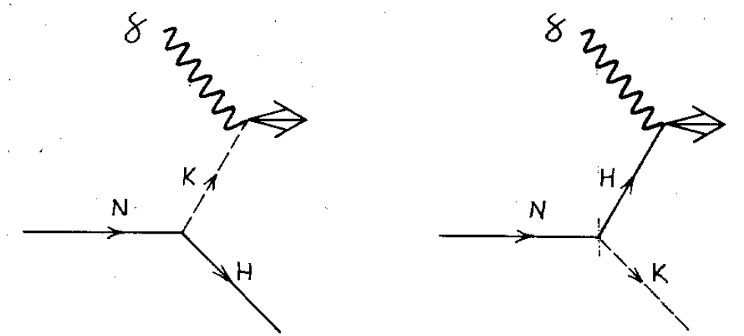
Symmetry Breaking in the Nucleon Sea
Dominant role of π⁺ for proton
predicts violation of Gottfried sum-rule
Thomas, Phys Lett 126B (1983) 97
_
Similar mechanism for kaons implies s – s
goes through zero for x of order 0.15
Signal and Thomas, 191 Phys Lett (1987) 205

Slide 9
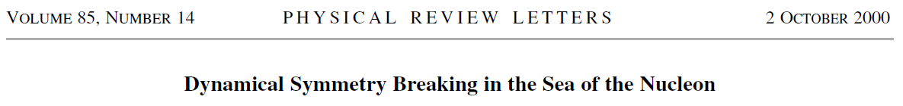
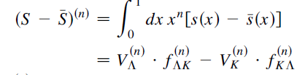
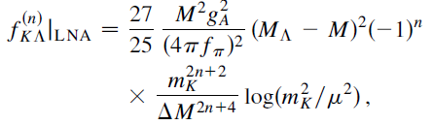
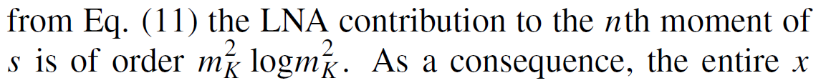

Slide 10
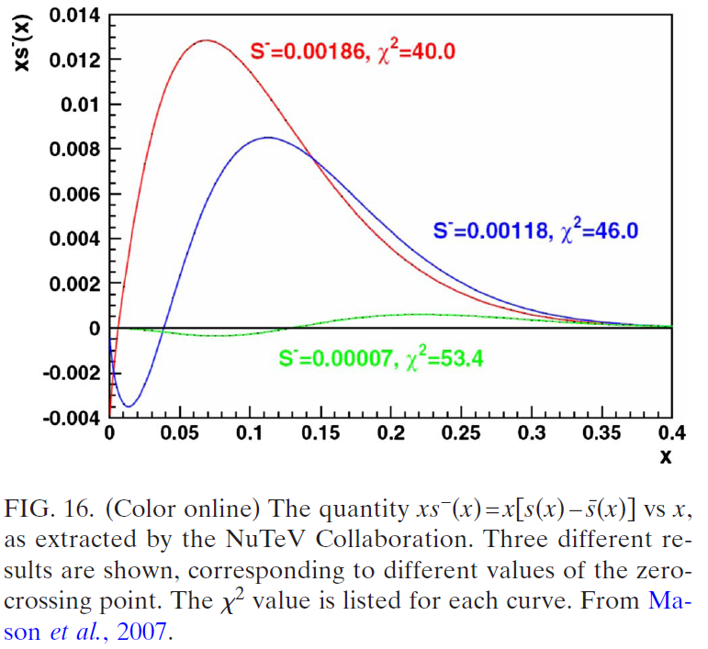
Dependence of NuTeV s- s on cross-over
_

Slide 11
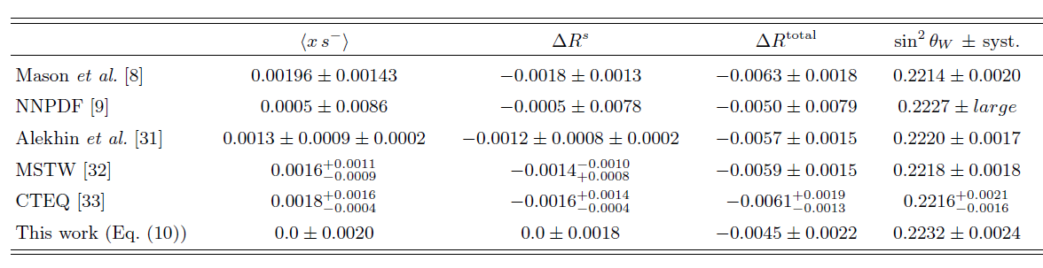
Strange Quark Asymmetry
Required in principle by chiral symmetry
(s and s have different chiral behaviour*)
Experimental constraint primarily through opposite sign di-muon production with neutrinos (CCFR & NuTeV)
_

Slide 12
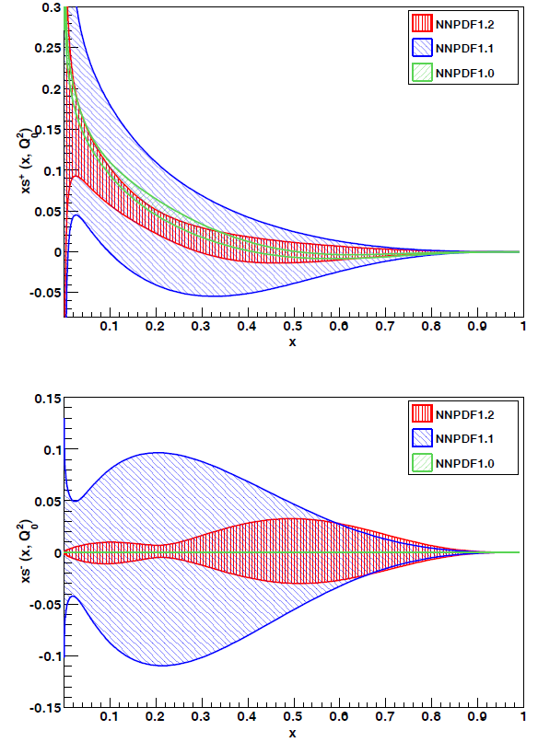
NNPDF Analysis
Uses neural net fitting
No functional form input
− no physics constraint
s⁻ very large in valence
region
Probably caused by
leakage of Cabibbo
suppressed d → c
We therefore omit their
error estimate
Ball et al., [NNPDF], arXiv: 0906.1958

Slide 13
Strange Quark Asymmetry
Required in principle by chiral symmetry
(s and s have different chiral behaviour)
Experimental constraint primarily through opposite sign di-muon production with neutrinos (CCFR & NuTeV)
_
We take : ΔR^{s} = -0.0011 ± 0.0014

Slide 14
Charge Symmetry and PDFs
Traditionally there is NO label “p” on PDF’s !
3
i π I₂
p (u)
Its assumed that charge symmetry:
is exact.
e
2
1
Good at < 1% : e.g. (m _{n} – m _{p}) / m _{p} ~ 0.1%
n (d)
That is: u ≡ u ^{p} = d ^{n}
d ≡ d ^{p} = u ^{n} etc.
Hence: _ _
F₂ ^{n} = 4/9 x ( d(x) + d(x) ) + 1/9 ( u(x) + u(x) )
up-quark in n
down-quark in n

Slide 15
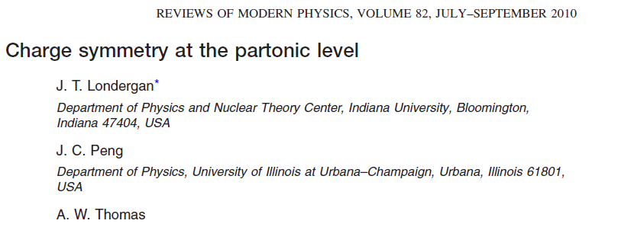

Slide 16
Effect of “Hyperfine” Interaction
Δ – N mass splitting → S=1 “di-quark” mass is 0.2 GeV greater S=0
SU(6) wavefunction for proton :
remove d-quark : ONLY S=1 left
c.f. remove u-quark : 50% S=0 and 50% S=1
u(x) dominates over d(x) for x > 0.3
u↑ dominates over u↓ at large x
and hence: g^{p}₁(x) > 0 at large x
Similarly g^{n}₁(x) > 0 at large x
Hence*:

Slide 17
Estimates of Charge Symmetry Violation*
Origin of effect is m _{d} ≠ m _{u}
Unambiguously predicted : δ d _{V} - δ u _{V} > 0
Biggest % effect is for minority quarks, i.e. δ d _{V}
Same physics that gives : d _{v} / u _{V} small as x → 1
and : g^{p}₁ and g^{n}₁ > 0 at large x
i.e. mass difference of quark pair spectators
to hard scattering
Close & Thomas,
Phys Lett B212
(1988) 227
* Sather, Phys Lett B274 (1992) 433;
Rodionov et al., Mod Phys Lett A9 (1994) 1799

Slide 18
More Modern (Confining) NJL Calculations
Cloet et al.,
Phys. Lett. B621, 246 (2005)
(μ = 0.4 GeV)

Slide 19
Application to Charge Symmetry Violation
d in p : uu left
u in n : dd left
Hence m₂ lower by
about 4 MeV for
d in p than u in n
Hence d ^{p} > u ^{p} at
large x.
From: Rodionov et al., Mod Phys Lett A9 (1994) 1799

Slide 20
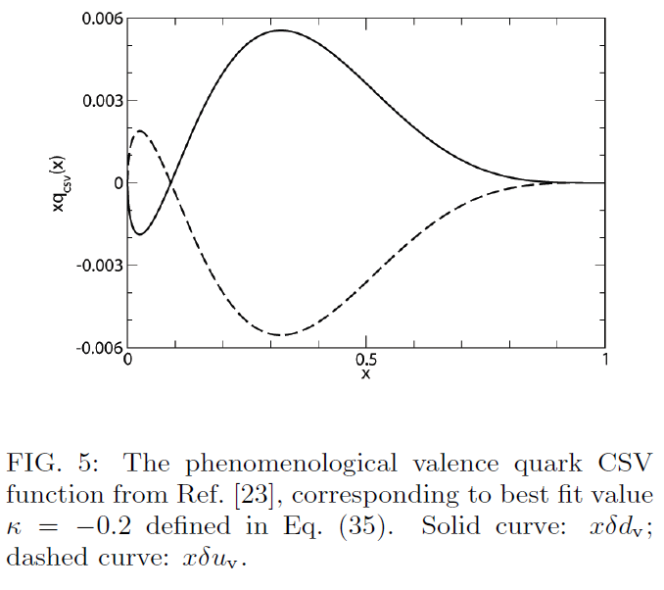
Remarkably Similar to MRST Fit 10 Years Later

Slide 21
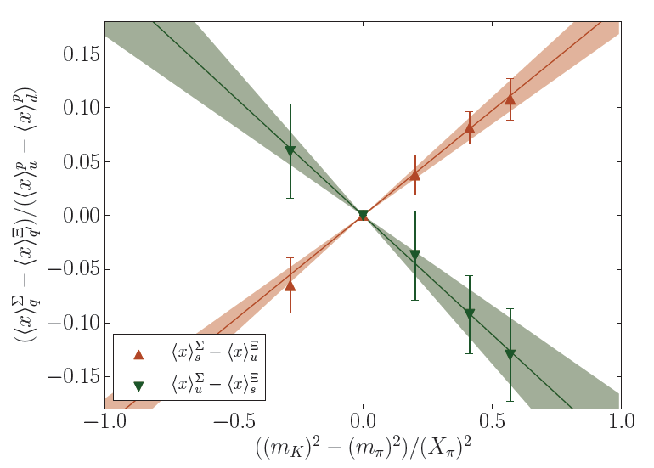
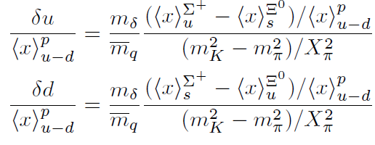

Strong support from recent lattice QCD calculation
Study moments of octet baryon PDFs
Deduce:
− in excellent agreement with phenomenological
estimates of Rodionov et al. and
Horsley et al., arXiv: 1012.0215 [hep-lat]
Phys Rev D83 (2011) 051501(R)

Slide 22
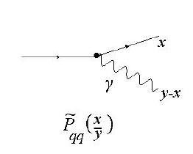
An additional source of CSV
In addition to the u-d mass difference, MRST ( Eur Phys J C39 (2005) 155 ) and Glück et al ( PRL 95 (2005) 022002 ) suggested
that “QED splitting”:
which is obviously larger for u than d quarks, would be an
additional source of CSV. Assume zero at some low scale and then evolve − so CSV from this source grows with Q²
Effect on NuTeV is exactly as for regular CSV and magnitude but grows logarithmically with Q²
For NuTeV it gives:
to which we assign 100% error

Slide 23
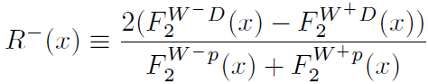
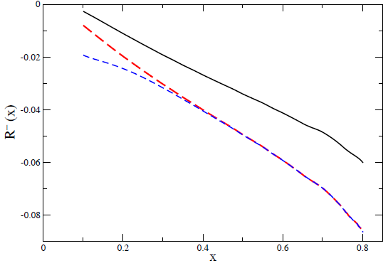
Test at Future EIC or LHeC – σ_{CC}
QED splitting
Plus
m_{d}-m_{u}
Total
including s⁻
Hobbs et al., arXiv 1101.3923 [hep-ph]

Slide 24
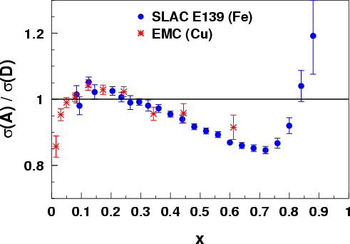
Classic Illustration: The EMC effect
The EMC Effect: Nuclear PDFs
Observation stunned and electrified the
HEP and Nuclear communities 20 years ago
Nearly 1,000 papers have been generated…..
Medium modifies the momentum distribution of the quarks!
J. Ashman et al., Z. Phys. C57, 211 (1993)
J. Gomez et al., Phys. Rev. D49, 4348 (1994)
Notes:
Cannot be fully explained by conventional nuclear physics

Slide 25
Recent Calculations for Finite Nuclei
Spin dependent EMC effect TWICE as large as unpolarized
Cloët et al., Phys. Lett. B642 (2006) 210 (nucl-th/0605061)

Slide 26
NuTeV Reassessed
New realization concerning EMC effect:
– isovector force in nucleus (like Fe) with N≠Z
effects ALL u and d quarks in the nucleus
– subtracting structure functions of extra neutrons is not enough
– there is a shift of momentum from
all u to all d quarks
This has same sign as charge symmetry violation
associated with m_{u}≠ m_{d}
Sign and magnitude of both effects exhibit
little model dependence
Cloet et al., arXiv: 0901.3559v1 ; Londergan et al., Phys Rev D67 (2003) 111901

Slide 27
Correction to Paschos-Wolfenstein from ρ_{p} - ρ_{n}
Excess of neutrons means d-quarks feel more repulsion than
u-quarks
Hence shift of momentum from all u to all d in the nucleus!
Negative change in ΔR_{PW} and hence sin²θ_{W} ↑
Isovector force controlled by ρ_{p} – ρ_{n} and symmetry energy of
nuclear matter − both well known!
N.B. ρ⁰ mean field included in QHD and QMC and earlier work
but no-one thought of this!!

Slide 28




Summary of Corrections to NuTeV Analysis
Isovector EMC effect:
− using NuTeV functional
CSV:
− again using NuTeV functional
Strangeness:
− this is largest uncertainty (systematic error) ; desperate need
for an accurate determination of s⁻(x) , e.g. semi-inclusive DIS?
Final result:
− c.f. Standard Model:
- 0.0011 ± 0.0014
Bentz et al., Phys Lett B693 (2010) 462
(arXiv: 0908.3198)

Slide 29
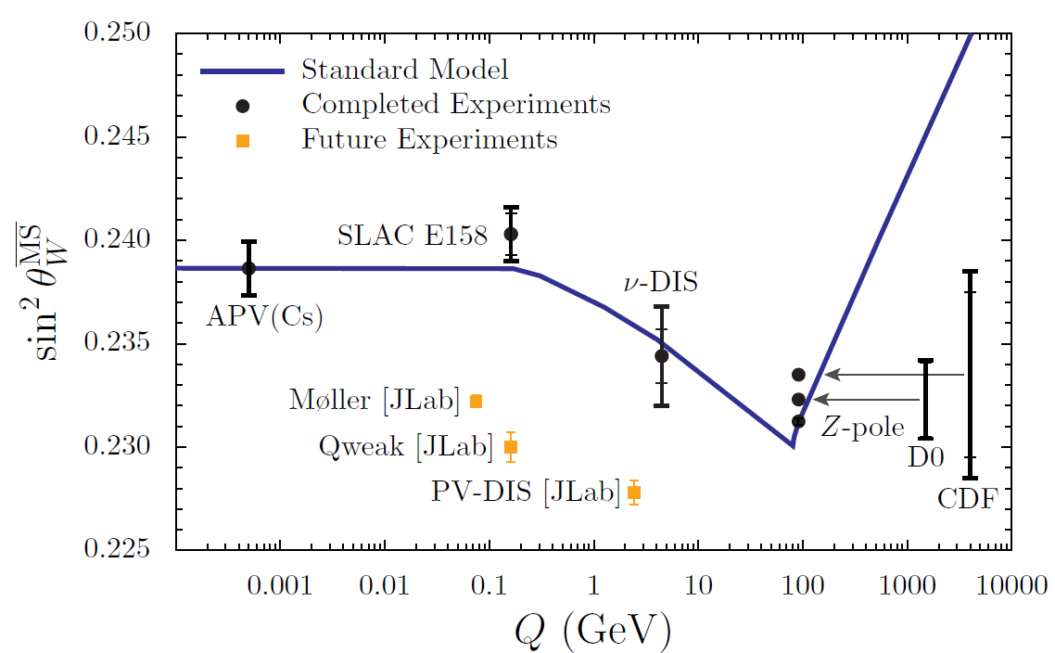
The Standard Model works… again
Bentz et al., Phys Lett B693 (2010) 462
(arXiv: 0908.3198)

Slide 30


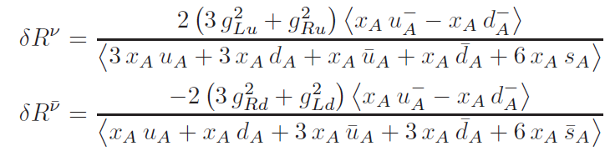
Separate Neutrino and Anti-Neutrino Ratios
Biggest criticism of this explanation was that NuTeV actually measured and , separately:
Claim we should compare directly with these.
Have done this:
Then moves from c.f. in the Standard Model to ;
moves from to ,
c.f. in SM
This is a tremendous improvement :
χ² changes from 7.2 to 2.6 for the two ratios!
Bentz et al., Phys Lett B693 (2010) 462
( arXiv: 0908.3198)

Slide 31
Summary
There are 3 well identified and unavoidable corrections to the NuTeV result
I. CSV:
a) m_{d} ≠ m_{u} : known and calculated a decade before NuTeV
− If not ignored would have reduced “anomaly” to ~2σ
2003: ~ model independent result for relevant moment
2011: Finally lattice results for δu⁺ and δd⁺ in excellent
agreement with phenomenology
✓

Slide 32
Summary (cont.)
B) QED Radiation:
− Physics clear but starting scale hypothesis
→ assign 100% error
− in future pin down at EIC
✓
2. Isovector EMC effect:
− more n than p in steel
→ isovector force felt by all quarks
− need a model BUT model fits all EMC data and
effect depends on ρ^{n} – ρ^{p} and symmetry energy,
both well known
(avoidable with isoscalar target!)
✓

Slide 33
Summary (cont.)
3. Strange quark asymmetry:
− theory suggests very small (Cao: < 1% of anomaly)
− experiment: very poorly determined
: compatible with zero or slightly positive
but relatively large systematic error
This error is unavoidable without better measurement!
BUT in any case the anomaly is completely removed
and the Standard Model lives again!

Slide 34
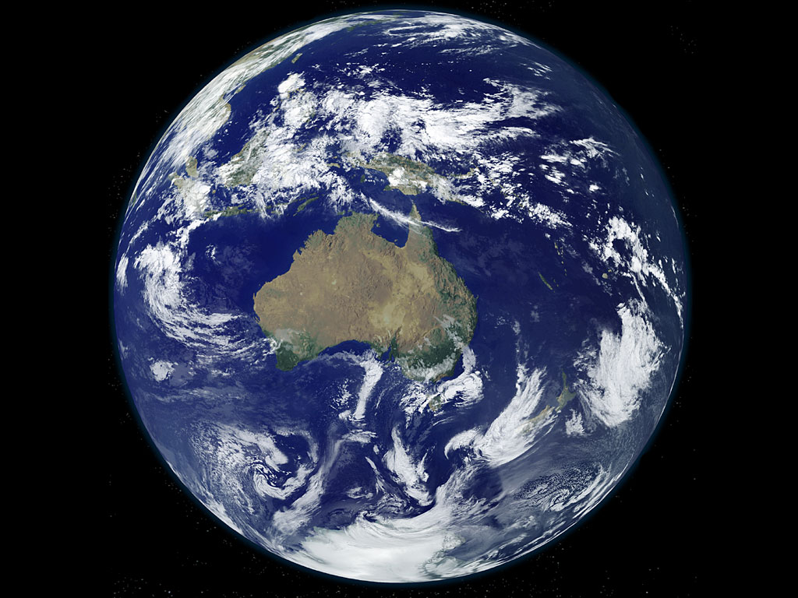

Slide 35
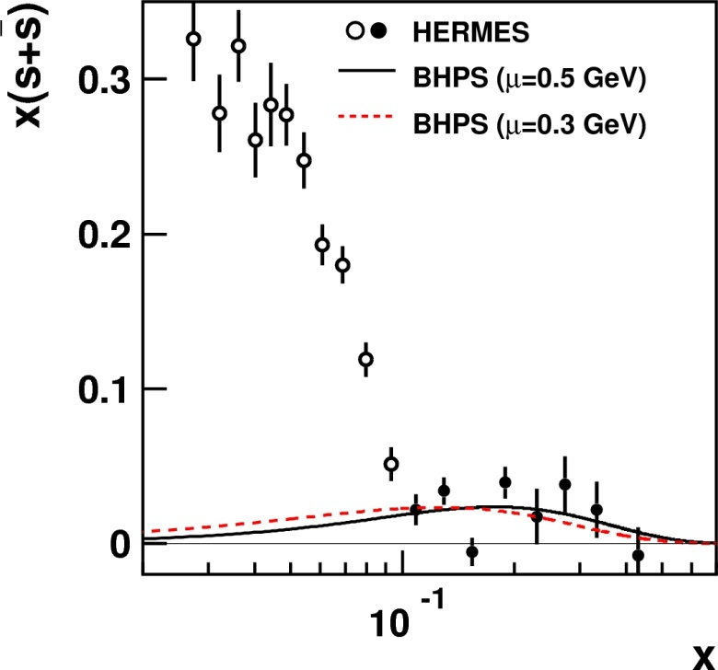

Slide 36
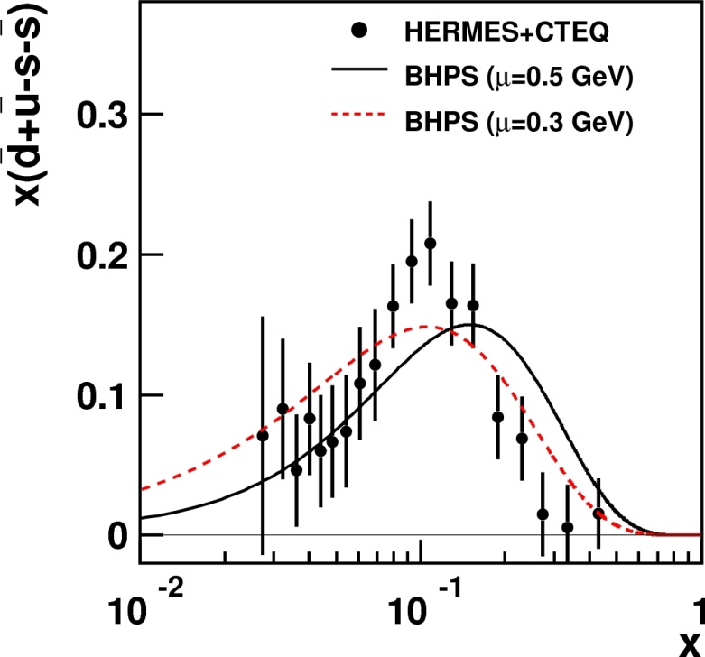

Slide 37
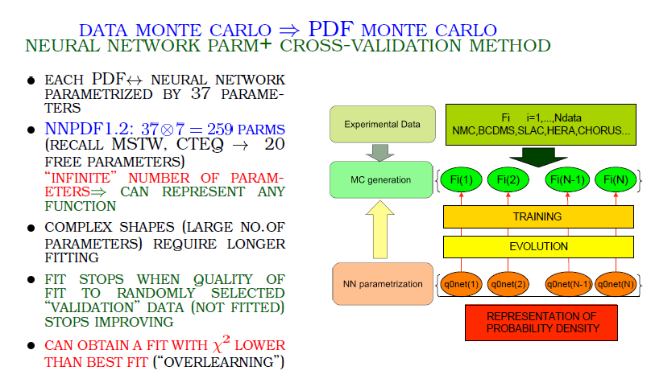
NNPDF – from Ball Dec 2009 (YKIS)

Slide 38
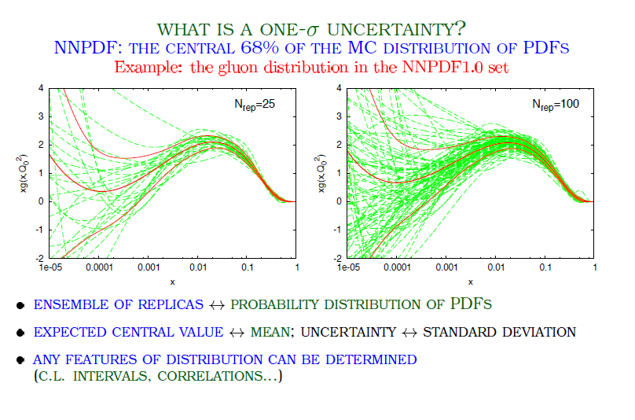
NNPDF (cont.)

Slide 39
Attempt to Understand this based on QMC
Two major, recent papers:
1. Guichon, Matevosyan, Sandulescu, Thomas,
Nucl. Phys. A772 (2006) 1.
2. Guichon and Thomas, Phys. Rev. Lett. 93 (2004) 132502
Built on earlier work on QMC: e.g.
3. Guichon, Phys. Lett. B200 (1988) 235
4. Guichon, Saito, Rodionov, Thomas,
Nucl. Phys. A601 (1996) 349
Major review of applications of QMC to many
nuclear systems:
5. Saito, Tsushima, Thomas,
Prog. Part. Nucl. Phys. 58 (2007) 1-167 (hep-ph/0506314)

Slide 41
More Modern (Confining) NJL Calculations
Cloet et al.,
Phys. Lett. B621, 246 (2005)
(μ = 0.4 GeV)

